Slide 1
July 22nd Update

Slide 2
Recap
Create ntuple files with new variables
Get plots of true pion histories, collinearity
Correlation between missing tracks and other colinear primaries?
Which pion history fails reconstruction most often?

Slide 3
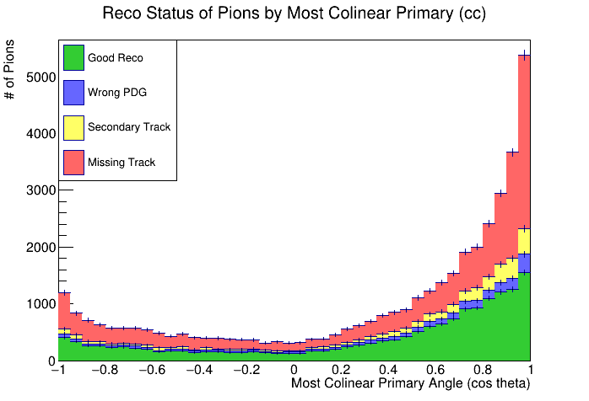
Efficiency by Most Collinear Primary
Suspected that a collinear primary may have interfered with reconstruction, mainly missing tracks

Slide 4
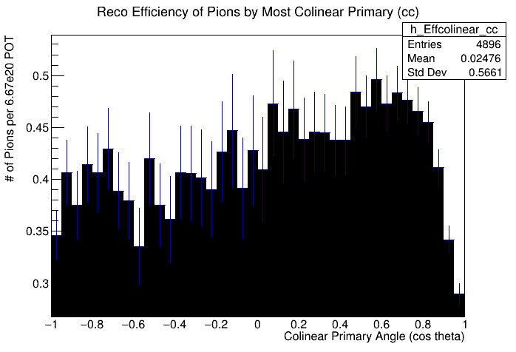
Efficiency by Most Collinear Primary
Suspected that a collinear primary may have interfered with reconstruction, mainly missing tracks

Slide 5
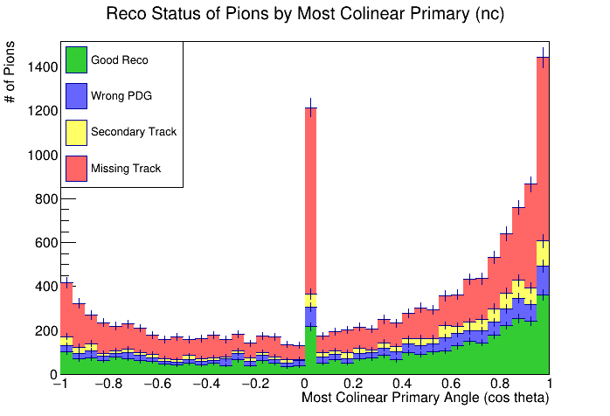
Efficiency by Most Collinear Primary
Suspected that a collinear primary may have interfered with reconstruction, mainly missing tracks

Slide 6
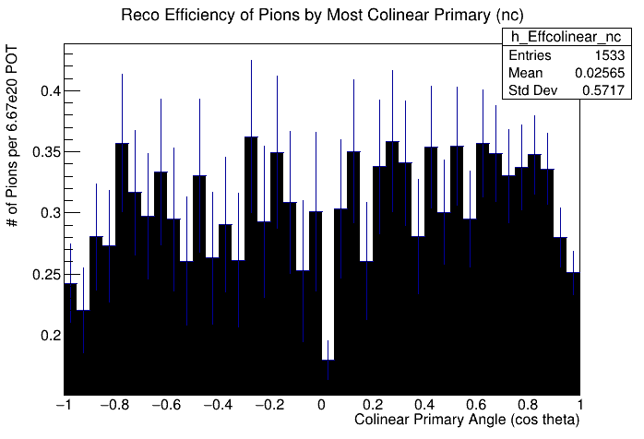
Efficiency by Most Collinear Primary
Suspected that a collinear primary may have interfered with reconstruction, mainly missing tracks

Slide 7
Efficiency by Pion History
What pion histories lead to which reco result?

Slide 8
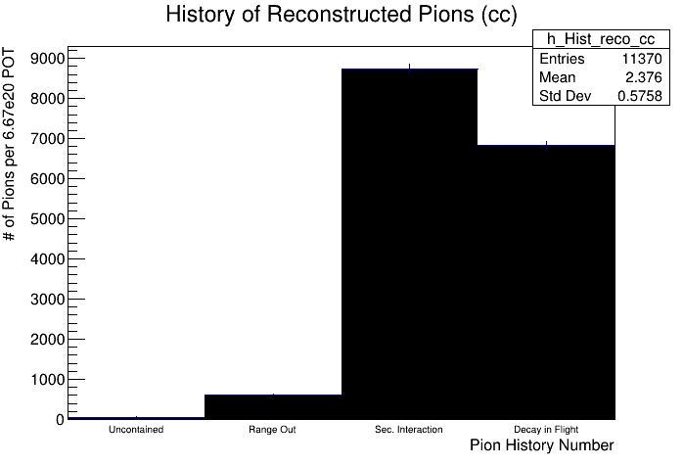
Efficiency by Pion History
What pion histories lead to which reco result?

Slide 9
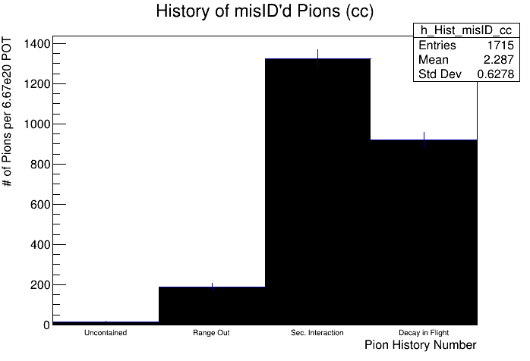
Efficiency by Pion History
What pion histories lead to which reco result?

Slide 10
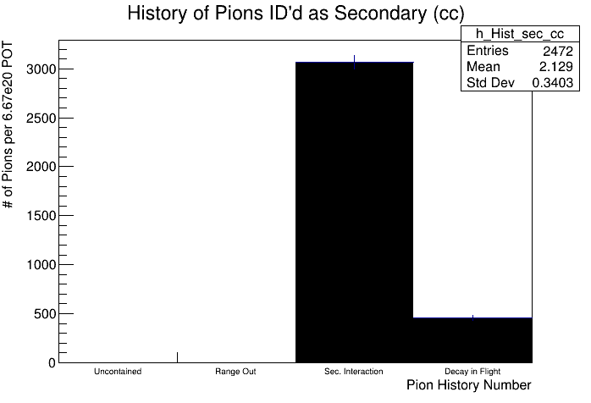
Efficiency by Pion History
What pion histories lead to which reco result?

Slide 11
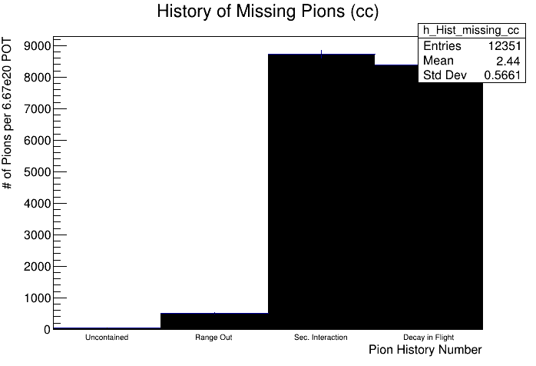
Efficiency by Pion History
What pion histories lead to which reco result?
Missing Reco predominantly of pions with Sec. interactions or decay in flight

Slide 12
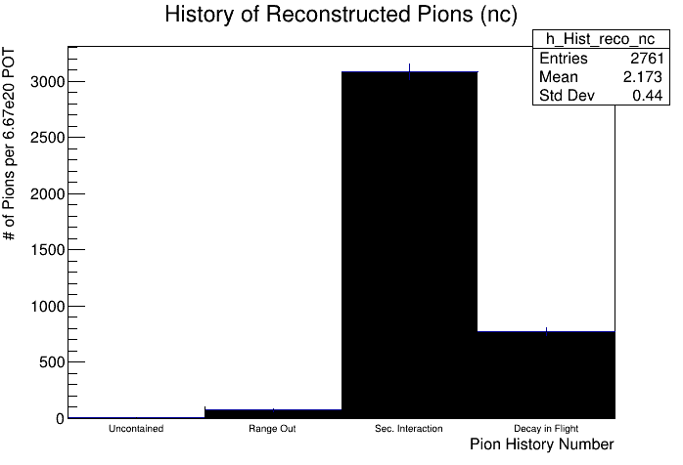
Efficiency by Pion History
What pion histories lead to which reco result?
Less contribution from decay-in-flight

Slide 13
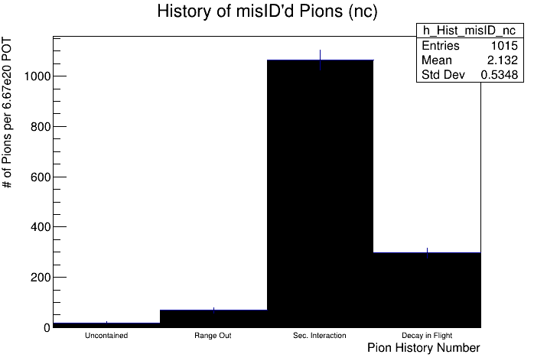
Efficiency by Pion History
What pion histories lead to which reco result?
Less contribution from decay-in-flight

Slide 14
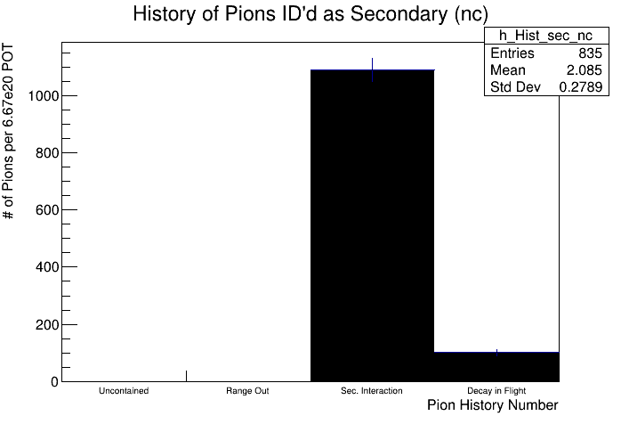
Efficiency by Pion History
What pion histories lead to which reco result?
Less contribution from decay-in-flight

Slide 15
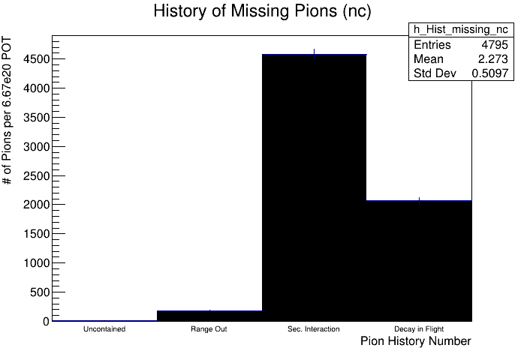
Efficiency by Pion History
What pion histories lead to which reco result?
Less contribution from decay-in-flight

Slide 16
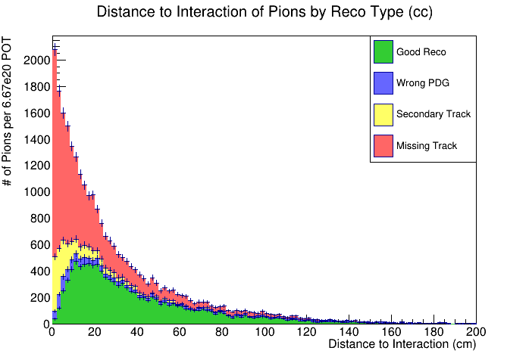
Efficiency by Distance to Interaction
High reco failure rate for low distance to interaction
Bins of 2 cm

Slide 17
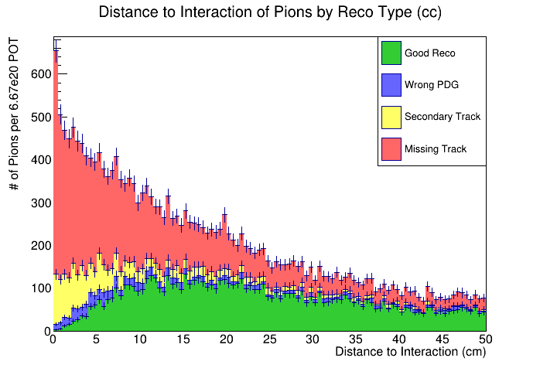
Efficiency by Distance to Interaction
High reco failure rate for low distance to interaction
Bins of 0.5 cm

Slide 18
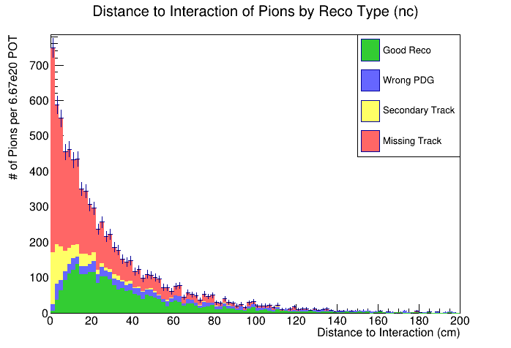
Efficiency by Distance to Interaction
High reco failure rate for low distance to interaction
Bins of 2 cm

Slide 19
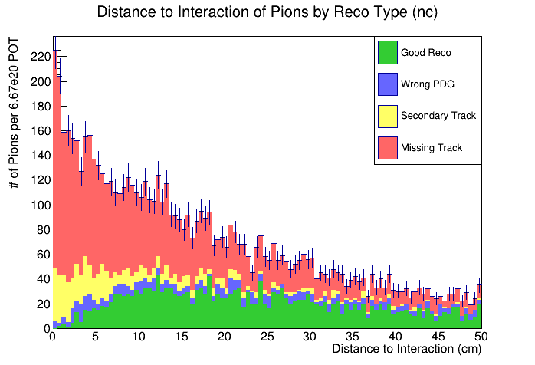
Efficiency by Distance to Interaction
High reco failure rate for low distance to interaction
Bins of 0.5 cm

